Slide 1


Distributed Databases
Not just a client/server system

Slide 2
Outline
Concepts
Advantages and disadvantages of distributed databases.
Functions and architecture for a DDBMS.
Distributed database design.
Levels of transparency.
Comparison criteria for DDBMSs.

Slide 3
Distributed
Database - A logically interrelated collection of shared data (and a description of this data), physically distributed over a computer network.
DBMS - Software system that permits the management of the distributed database and makes the distribution transparent to users.

Slide 4
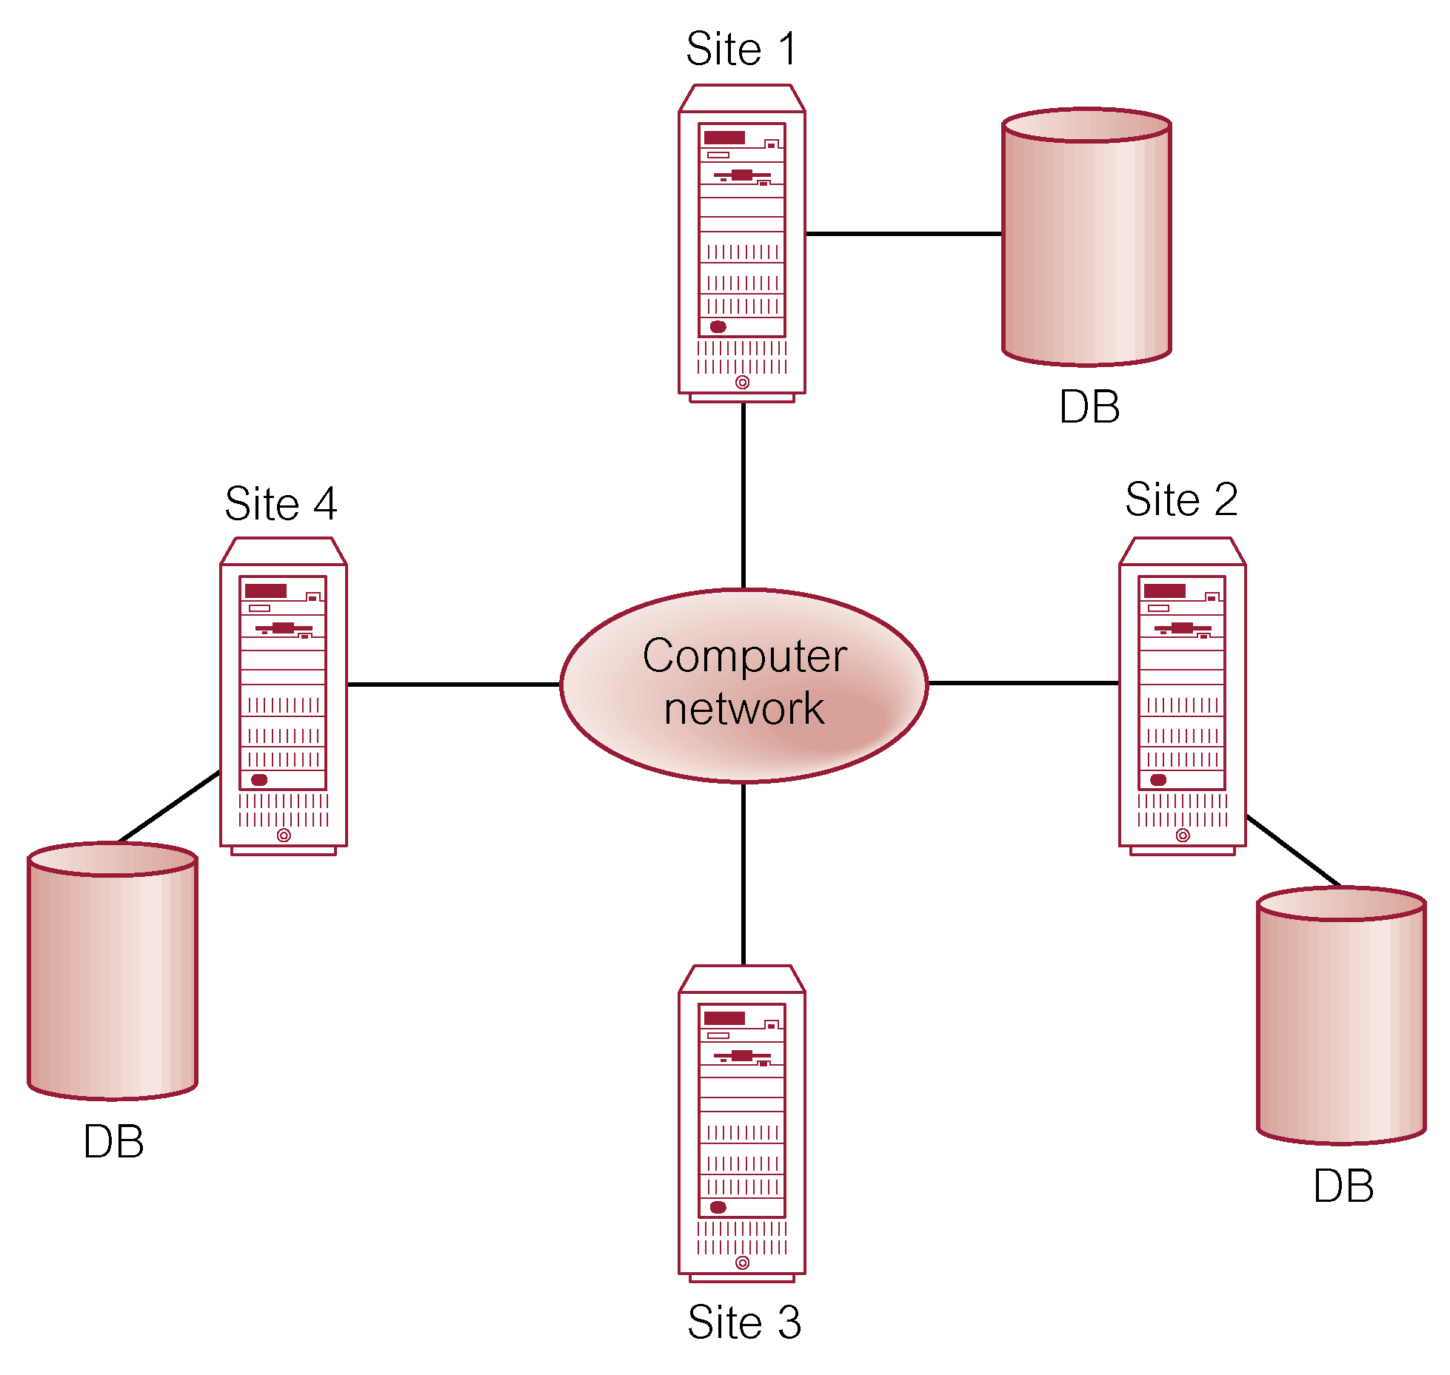
Distributed DBMS

Slide 5

Why Distribute Data?

Slide 6
Advantages of DDBMSs
Reflects organizational structure
Improved shareability and local autonomy
Improved availability
Improved reliability
Improved performance
Economics
Modular growth

Slide 7
Disadvantages of DDBMSs
Complexity
Cost
Security
Integrity control more difficult
Lack of standards
Lack of experience
Database design more complex

Slide 8
Reference Architecture for DDBMS
Due to diversity, no accepted architecture equivalent to ANSI/SPARC 3-level architecture.
A reference architecture consists of:
  Set of global external schemas.
  Global conceptual schema (GCS).
  Fragmentation schema and allocation schema.
  Set of schemas for each local DBMS conforming to 3-level ANSI/SPARC .
Some levels may be missing, depending on levels of transparency supported.
Can be homogeneous or heterogeneous

Slide 9
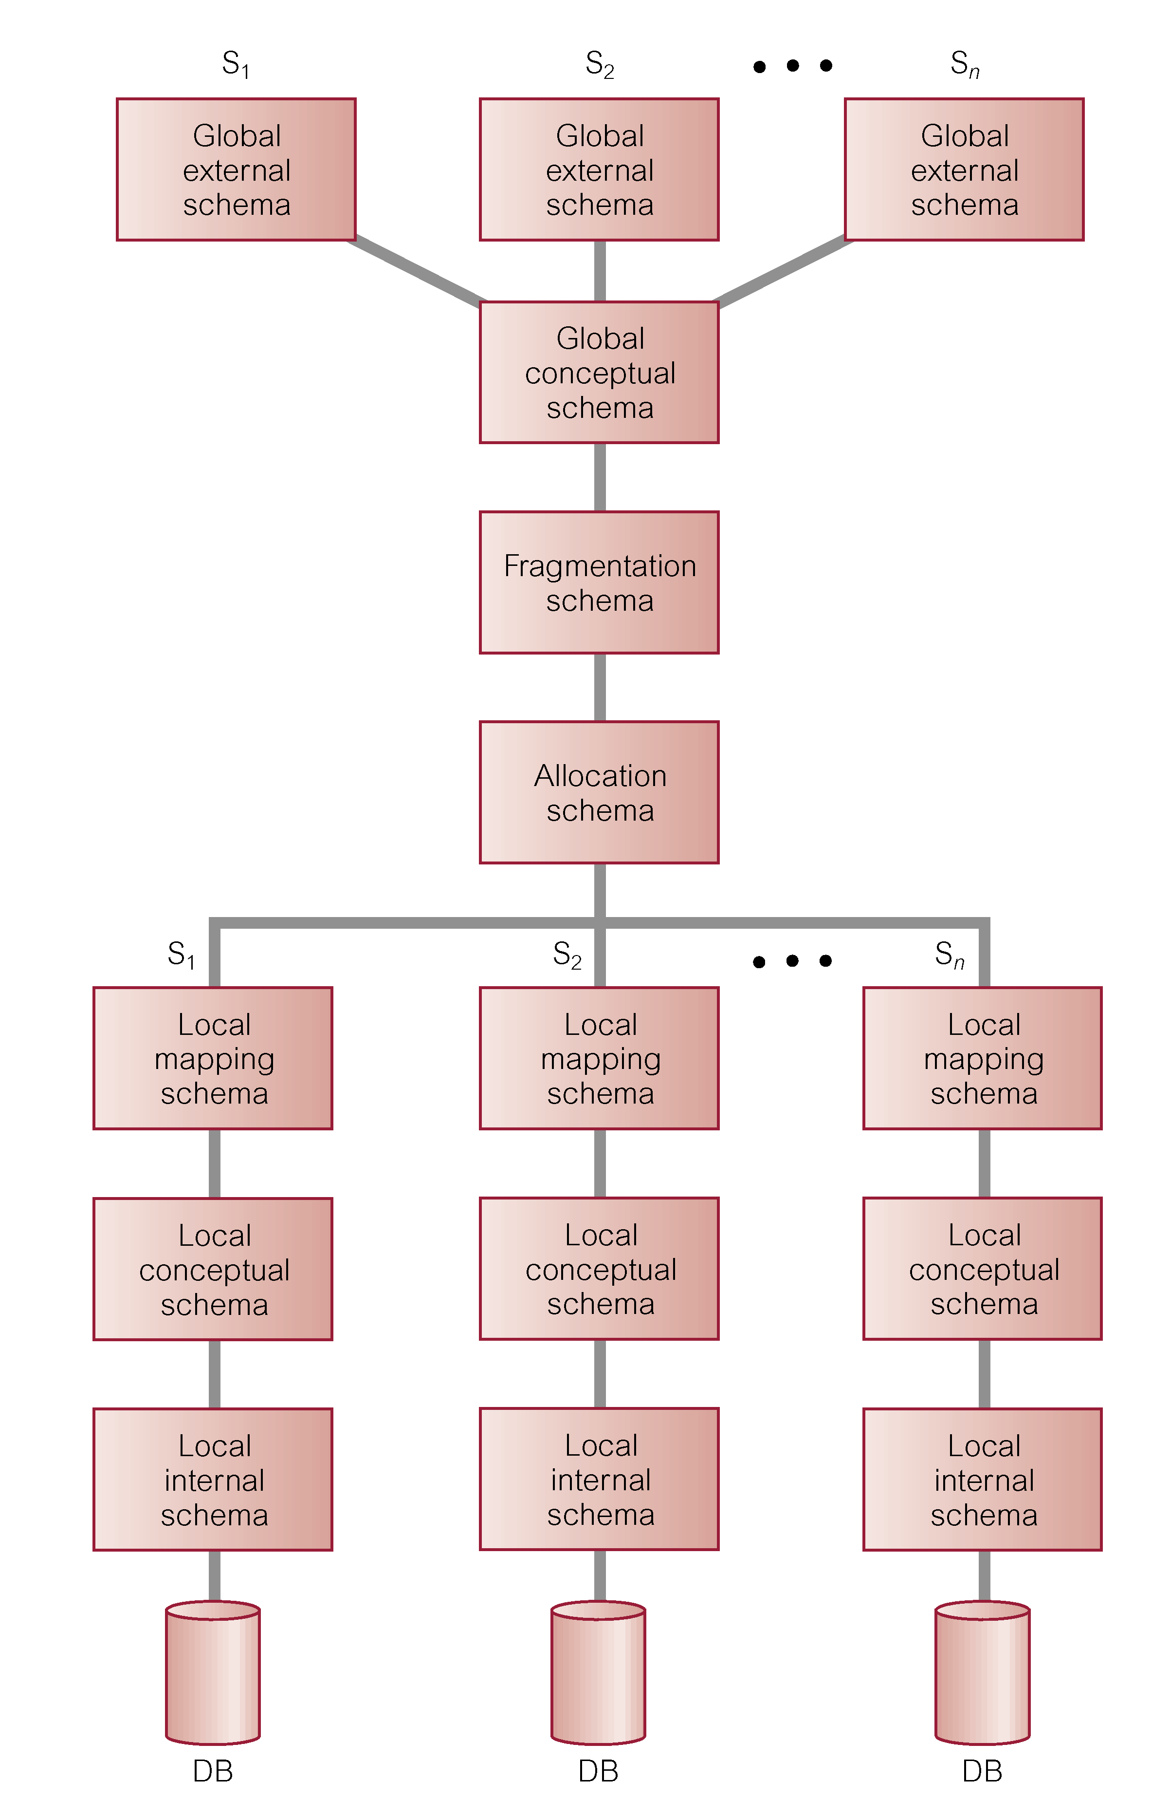
Reference Architecture for DDBMS

Slide 10
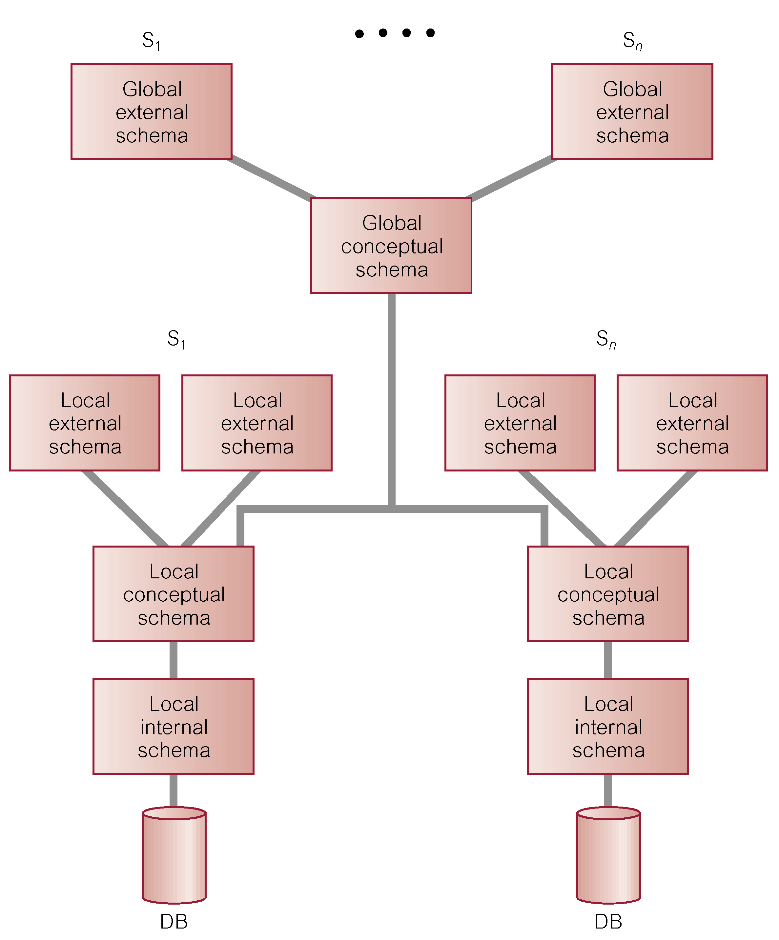
Reference Architecture for Tightly-Coupled FMDBS

Slide 11
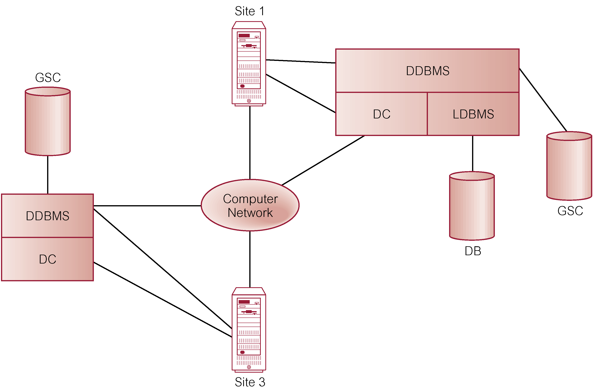
Components of a DDBMS

Slide 12
Issues with DDBMS
  Fragmentation
  Relation may be divided into a number of sub-relations, which are then distributed.
  Allocation
  Each fragment is stored at site with "optimal" distribution.
  Replication
  Copy of fragment may be maintained at several sites.

Slide 13
Fragmentation
Horizontal – subset of rows
Vertical – subset of columns
  Each fragment must contain primary key
  Other columns can be replicated
Mixed – both horizontal and vertical
Derived – natural join first to get additional information required then fragment
Must be able to reconstruct original table
Can query and update through fragment

Slide 14
Fragmentation
  Strategize to achieve:
    Locality of Reference
    Improved Reliability and Availability
    Improved Performance
    Balanced Storage Capacities and Costs
    Minimal Communication Costs.
  Quantitative and quantitative information
  Correctness of Fragmentation
    Completeness
    Reconstruction
    Disjointness.

Slide 15

Replication
Storing data at multiple sites
Example – Internet grocer with multiple warehouses.
CUSTOMER (Cust#, Addr, Location)
  Customer info at central location
  Location is warehouse that makes deliveries
Where do we store tables?
Fragment?
Replicate?

Slide 16
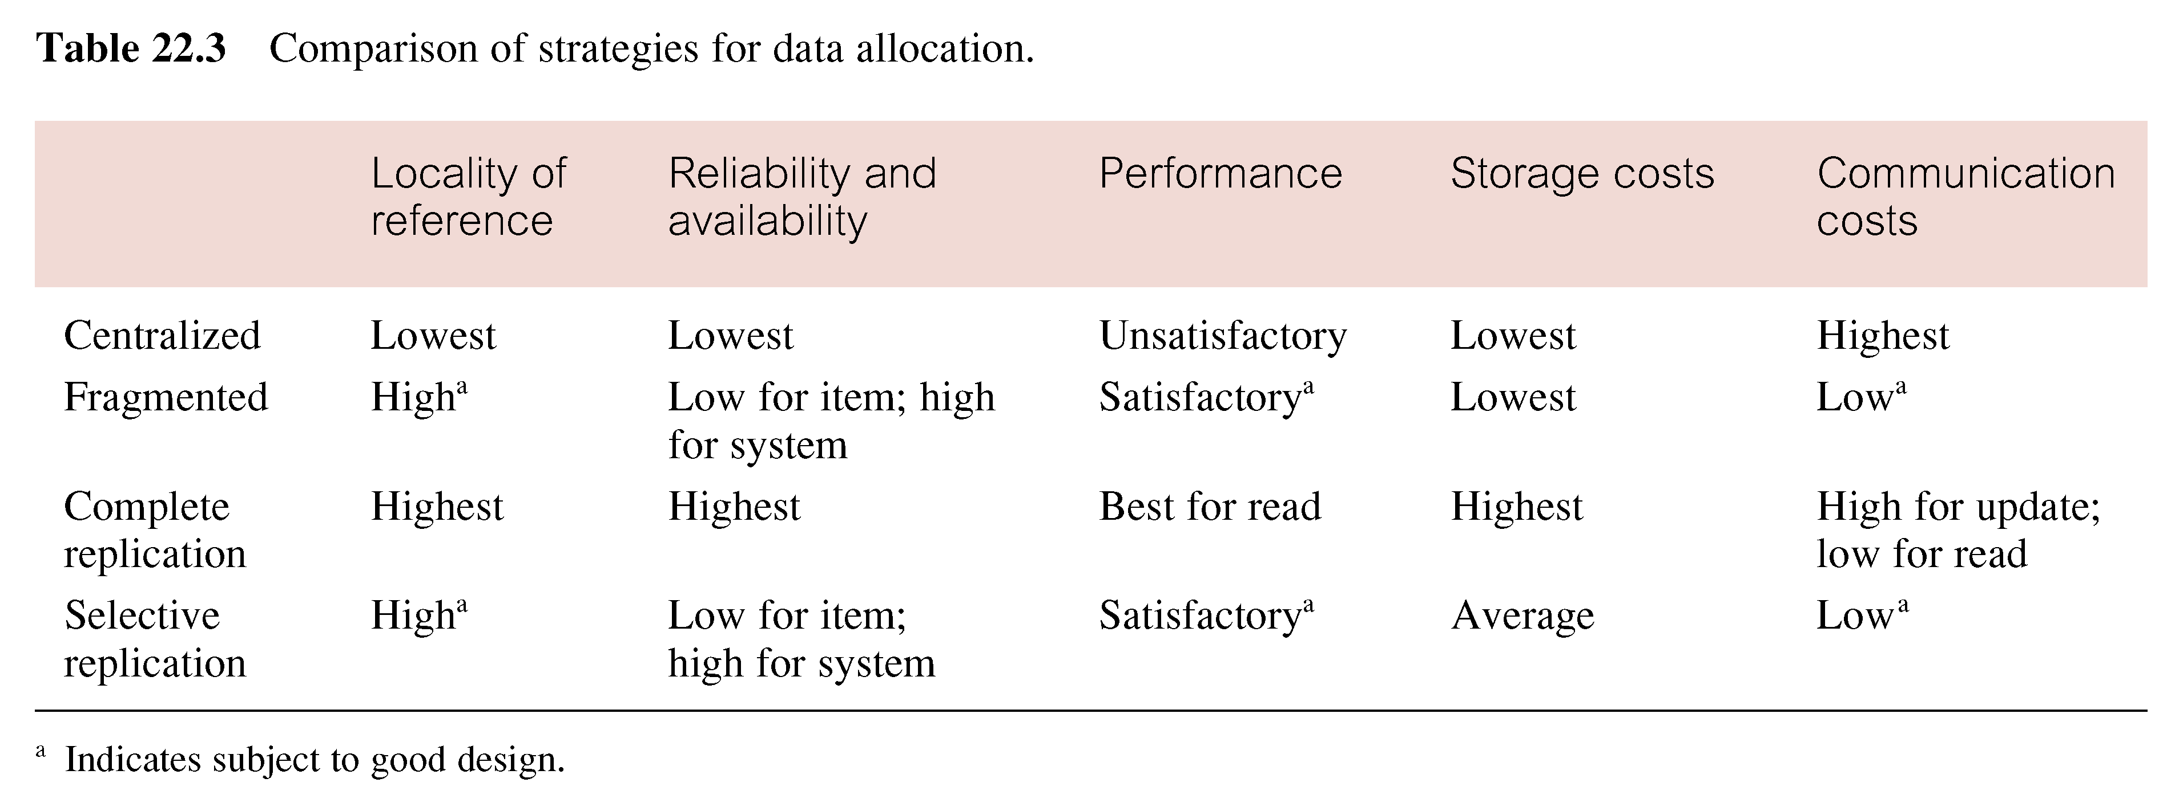

Slide 17
Optimization – Query Plan
Local + Global query optimizer
Example
  STUDENT(Id, Major) at site B
  TRANSCRIPT(StudID, CrsCode) at site C
  Application at site A wants to join tables
  Lengths
    Id and StudID: 9 bytes
    Major: 3 bytes
    CrsCode: 6 bytes
  STUDENT has 5,000 tuples
  TRANSCRIPT
    5,000 students registered for at least 1 course
    On average each student registers for 4 courses
How many bytes must be transferred to do join?

Slide 18
Transparencies in a DDBMS
Distribution Transparency
  Fragmentation Transparency
  Location Transparency
  Replication Transparency
  Local Mapping Transparency
  Naming Transparency
Transaction Transparency
  Concurrency Transparency
  Failure Transparency
Performance Transparency
  DBMS Transparency
DBMS Transparency

Slide 19
Performance Transparency - Example
Property(propNo, city) 10000 records in London
Client(clientNo,maxPrice) 100000 records in Glasgow
Viewing(propNo, clientNo) 1000000 records in London
SELECT p.propNo
FROM Property p INNER JOIN
Client c INNER JOIN Viewing v ON c.clientNo = v.clientNo)
ON p.propNo = v.propNo
WHERE p.city=‘Aberdeen’ AND c.maxPrice > 200000;

Slide 20
Performance Transparency - Example
Assume:
Each tuple in each relation is 100 characters long.
10 renters with maximum price greater than £200,000.
100 000 viewings for properties in Aberdeen.
Computation time negligible compared to communication time.

Slide 21
Date’s 12 Rules for a DDBMS
0. Fundamental Principle
  To the user, a distributed system should look exactly like a nondistributed system.
1. Local Autonomy
2. No Reliance on a Central Site
3. Continuous Operation
4. Location Independence
5. Fragmentation Independence
6. Replication Independence

Slide 22
Date’s 12 Rules for a DDBMS
7. Distributed Query Processing
8. Distributed Transaction Processing
9. Hardware Independence
10. Operating System Independence
11. Network Independence
12. Database Independence
Last four rules are ideals.

Slide 23
Distributed Transaction Management
DDBMS must also ensure indivisibility of each sub-transaction.
DDBMS must ensure:
  synchronization of subtransactions with other local transactions executing concurrently at a site;
  synchronization of subtransactions with global transactions running simultaneously at same or different sites.
Global transaction manager (transaction coordinator) at each site, to coordinate global and local transactions initiated at that site.

Slide 24
Distributed Locking
  Centralized locking
  Primary Copy 2PL
  Distributed 2PL
  Majority Locking

Slide 25
Centralized Locking
Single site that maintains all locking information.
One lock manager for whole of DDBMS.
Local transaction managers involved in global transaction request and release locks from lock manager.
Or transaction coordinator can make all locking requests on behalf of local transaction managers.
Advantage - easy to implement.
Disadvantages-bottlenecks and lower reliability

Slide 26
Primary Copy 2PL
Lock managers distributed to a number of sites.
For replicated data item, one copy is chosen as primary copy, others are slave copies
Only need to write-lock primary copy of data item that is to be updated.
Once primary copy has been updated, change can be propagated to slaves.
Disadvantages - deadlock handling is more complex
Advantages - lower communication costs and better performance than centralized 2PL.

Slide 27
Distributed 2PL
Lock managers distributed to every site.
Each lock manager responsible for locks for data at that site.
If data not replicated, equivalent to primary copy 2PL.
Otherwise, implements a Read-One-Write-All (ROWA) replica control protocol.
Disadvantages - deadlock handling more complex; communication costs higher than primary copy 2PL.

Slide 28
Majority Locking
Extension of distributed 2PL.
To read or write data item replicated at n sites, sends a lock request to more than half the n sites where item is stored.
Transaction cannot proceed until majority of locks obtained.
Overly strong in case of read locks.

Slide 29
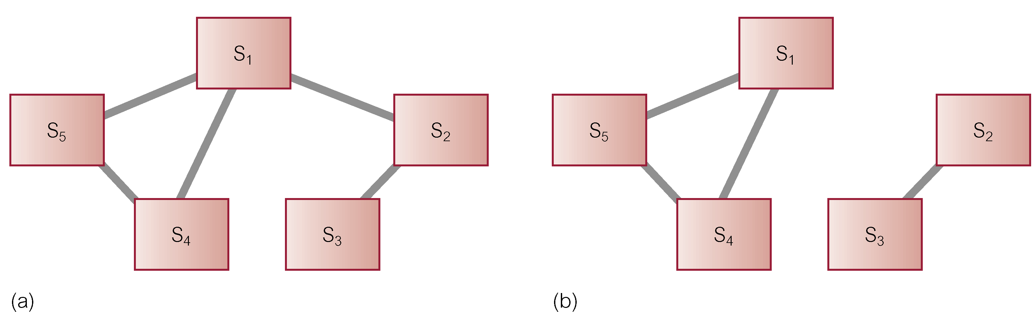
Distributed Recovery Control
DDBMS is highly dependent on ability of all sites to be able to communicate reliably with one another.
Communication failures can result in network becoming split into two or more partitions.
May be difficult to distinguish whether communication link or site has failed.

Slide 30
Two-Phase Commit (2PC)
Two phases: a voting phase and a decision phase.
Coordinator asks all participants whether they are prepared to commit transaction.
  If one participant votes abort, or fails to respond within a timeout period, coordinator instructs all participants to abort transaction.
  If all vote commit, coordinator instructs all participants to commit.
All participants must adopt global decision.

Slide 31
Two-Phase Commit (2PC)
If participant votes abort, free to abort transaction immediately
If participant votes commit, must wait for coordinator to broadcast global-commit or global-abort message.
Protocol assumes each site has its own local log and can rollback or commit transaction reliably.
If participant fails to vote, abort is assumed.
If participant gets no vote instruction from coordinator, can abort.

Slide 32
Where are we today?
Currently some prototype and special-purpose DDBMSs, and many of the protocols and problems are well understood.
However, to date, general-purpose DDBMSs have not been widely accepted.
Instead, database replication, the copying and maintenance of data on multiple servers, may be more preferred solution.
Every major database vendor has replication solution.

Slide 33
Synchronous versus Asynchronous Replication
Synchronous – updates to replicated data are part of enclosing transaction.
  If one or more sites that hold replicas are unavailable transaction cannot complete.
  Large number of messages required to coordinate synchronization.
Asynchronous - target database updated after source database modified.
Delay in regaining consistency may range from few seconds to several hours or even days.

Slide 34
Mobile Database
Database that is portable and physically separate from a centralized database server but is capable of communicating with server from remote sites allowing the sharing of corporate data.
Office’ may accompany remote worker in form of laptop, PDA (Personal Digital Assistant), or other Internet access device.

Slide 35
Mobile DBMS
Functionality required of mobile DBMSs includes ability to:
  communicate with centralized database server through modes such as wireless or Internet access;
  replicate data on centralized database server and mobile device;
  synchronize data on centralized database server and mobile device;
  capture data from various sources such as Internet;
  manage/analyze data on the mobile device;
  create customized mobile applications.

Slide 36
Oracle’s DDBMS Functionality
Net8 is Oracle’s data access application to support communication between clients and servers.
Net8 enables both client-server and server-server communications across any network, supporting both distributed processing and distributed DBMS capability.
Even if a process is running on same machine as database instance, Net8 still required to establish its database connection.
Net8 also responsible for translating any differences in character sets or data representations that may exist at operating system level.

Slide 37
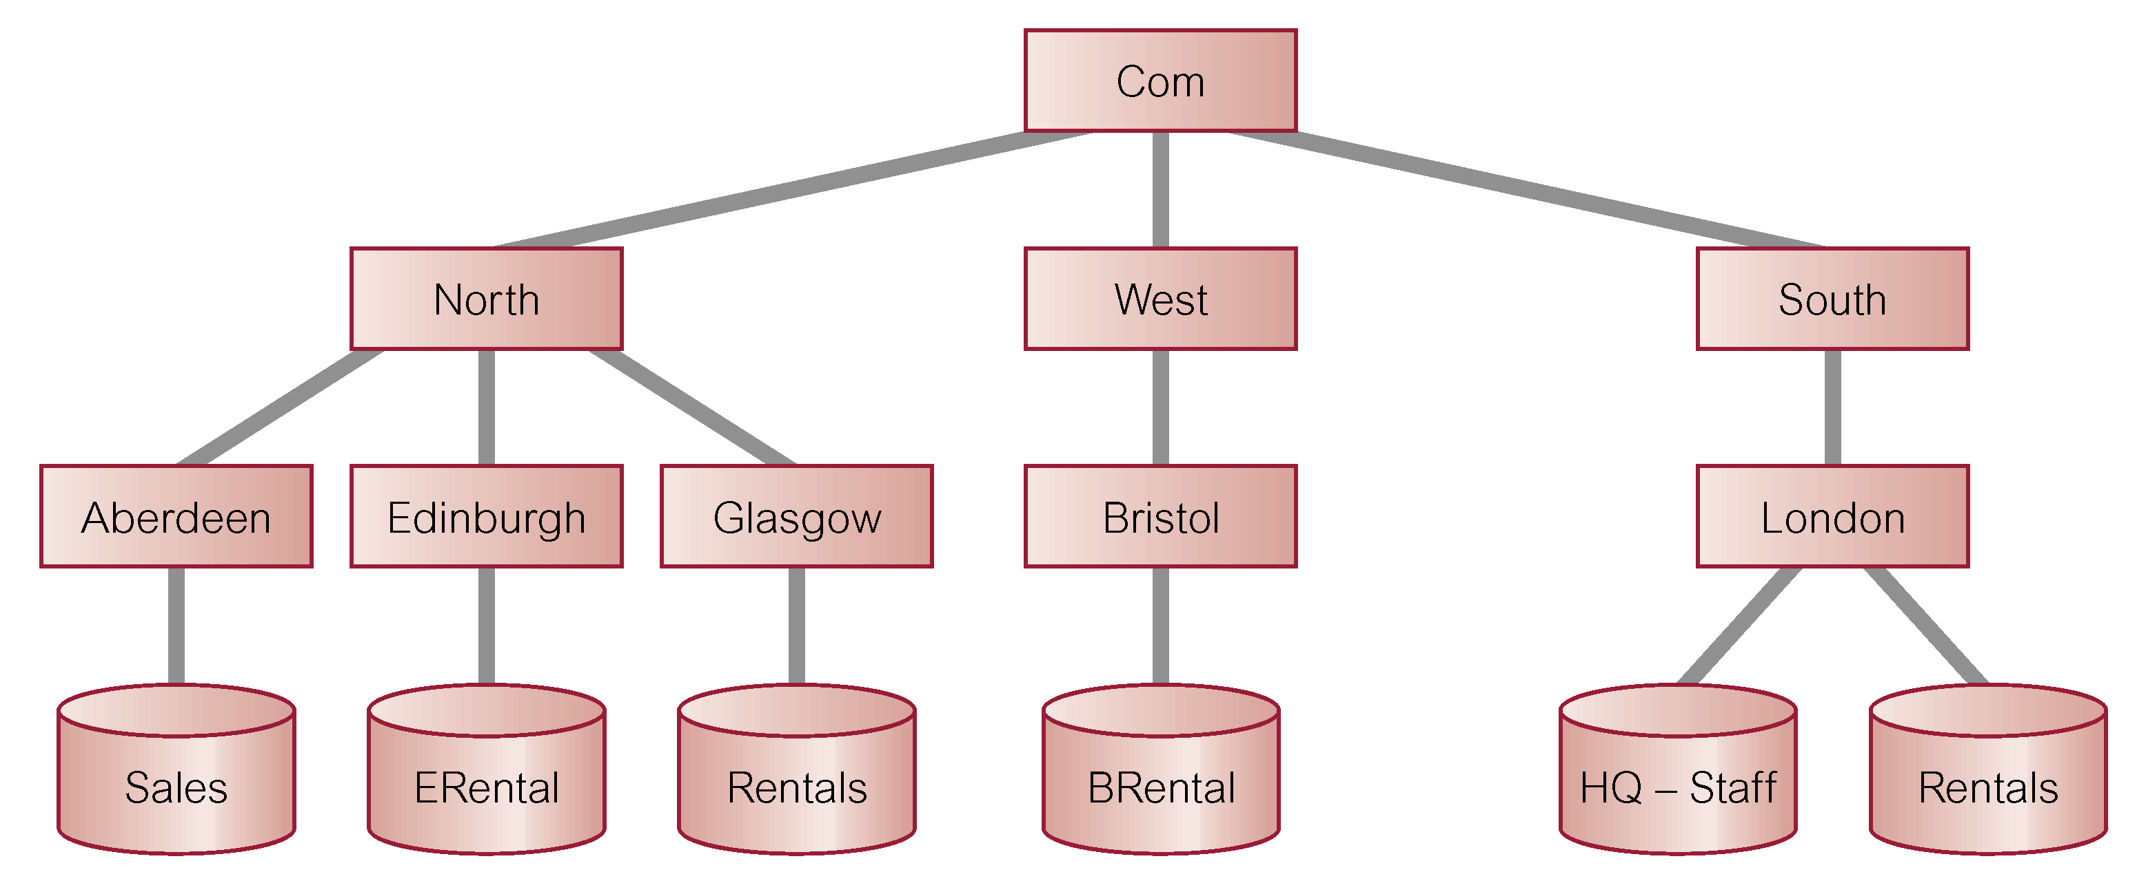
Global Database Names
Each distributed database is given a global database name, distinct from all databases in system. Name formed by prefixing database’s network domain name with local database name. Domain name must follow standard Internet conventions.

Slide 38
Database Links
DDBs in Oracle are built on database links, which define communication path from one Oracle database to another.
Purpose of database links is to make remote data available for queries and updates, essentially acting as a type of stored login to the remote database.
For example:
  CREATE PUBLIC DATABASE LINK
  RENTALS.GLASGOW.NORTH.COM;

Slide 39
Database Links
Once database link has been created, it can be used to refer to tables and views on the remote database by appending @databaselink to table or view name.
For example:
  SELECT *
  FROM Staff@RENTALS.GLASGOW.NORTH.COM;

Slide 40
Oracle Replication
Oracle Advanced Replication supports both synchronous and asynchronous replication.
It allows tables and supporting objects, such as views, triggers, and indexes, to be replicated.
In Standard Edition, there can be only one master site that can replicate changes to other slave sites.
In Enterprise Edition, there can be multiple master sites and updates can occur at any of these sites.

Slide 41
Types of Replication
(1) Read-only snapshots (or materialized views). A master table is copied to one or more remote databases. Changes in the master table are reflected in the snapshot tables whenever snapshot refreshes, as determined by the snapshot site.
(2) Updateable snapshots Similar to read-only snapshots except that the snapshot sites are able to modify data and send their changes back to the master site. Again, snapshot site determines frequency of refreshes and frequency with which updates are sent back to the master site.

Slide 42
Types of Replication
(3) Multimaster replication Table is copied to one or more remote databases, where table can be updated. Modifications are pushed to the other database at an interval set by DBA for each replication group.
(4) Procedural replication A call to a packaged procedure or function is replicated to one or more databases.

Slide 43
Creating Snapshots
CREATE SNAPSHOT Staff
REFRESH FAST
START WITH sysdate NEXT sysdate + 7
WITH PRIMARY KEY
AS SELECT *
FROM Staff@RENTALS.LONDON.SOUTH.COM WHERE branchNo = ‘B003’;

